Slide 1
Via-Stripline Modeling
Yifan Ding, Hyunwook Park, and Chulsoon Hwang
09/04/2024

Slide 2


Via Model
Port 1
Through-hole via
C_{a}
C_{top} = C_{a} + C_{b}
C_{bot} = C_{a} + C_{b}
Y’ and Y₀ are calculated for the whole cavity
C_{top}
$$Y^{′}$$
$$Y_{0}$$
C_{b}
C_{bot}
h_{cavity}
C_{b}
C_{a}
Port 2

Slide 3
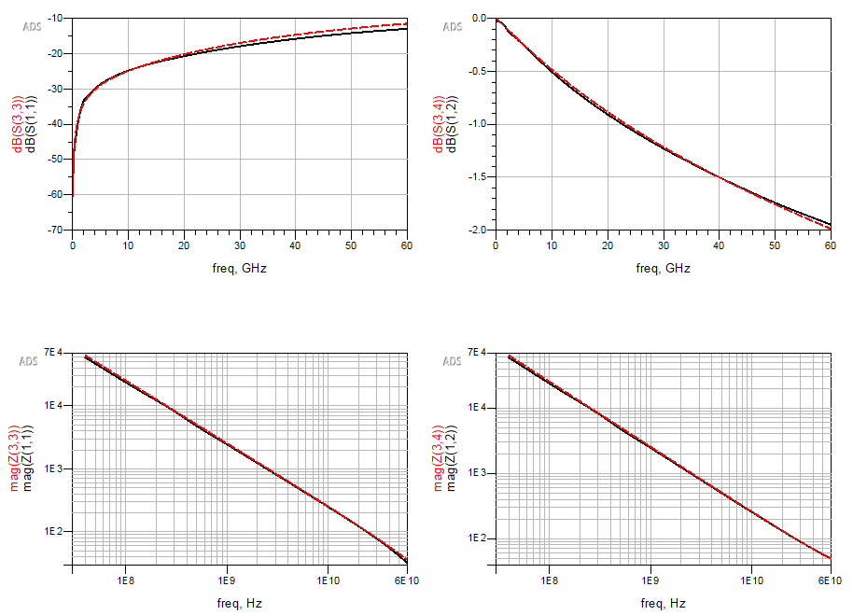
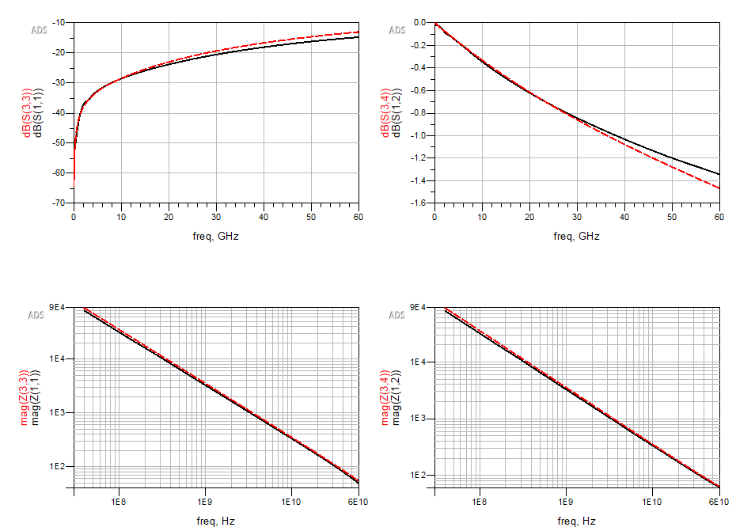
1 Cavity – Via Model
Port 1
r_via = 5mil
t = 1mil
h = 12mil
Frequency dependent model
HFSS
Calculation
r_anti = 15mil
h = 12mil
Port 2
h = 8mil
S11
S12
S11
S12
Z11
Z12
Z11
Z12

Slide 4
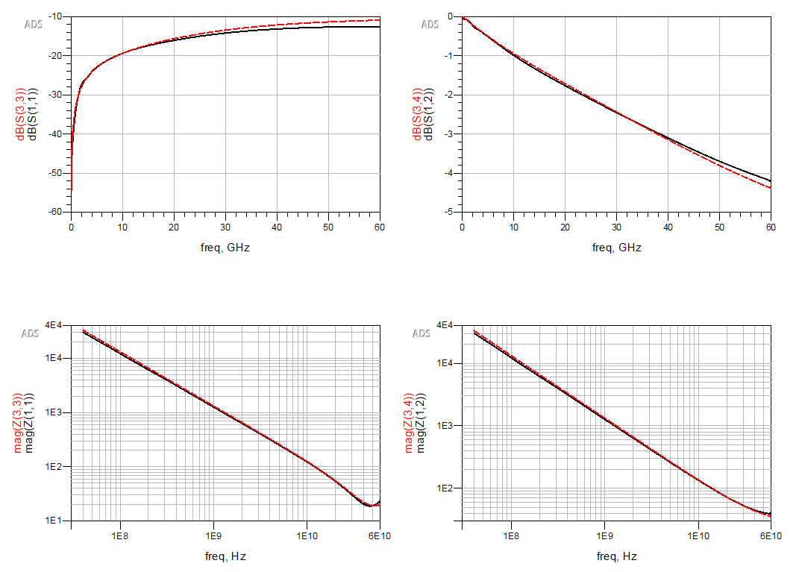
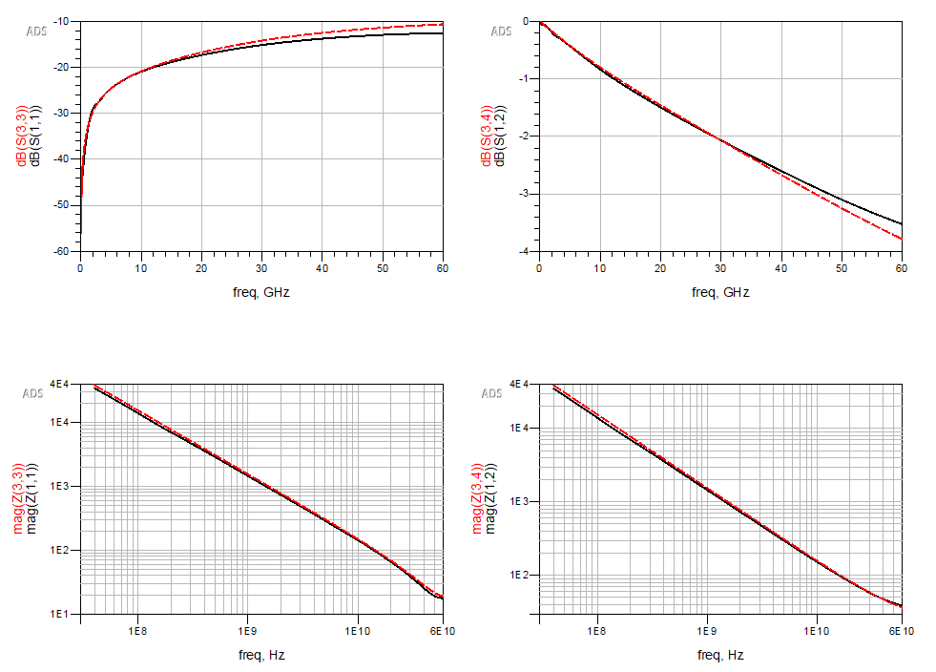
2 Cavities – Via Model
HFSS
Calculation
12mil + 12mil
12mil + 8mil
S11
S12
S11
S12
Z11
Z12
Z11
Z12

Slide 5
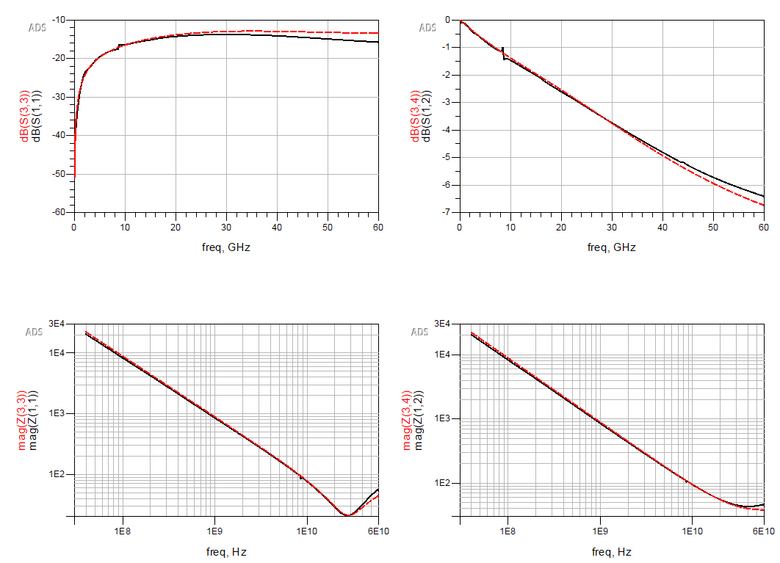
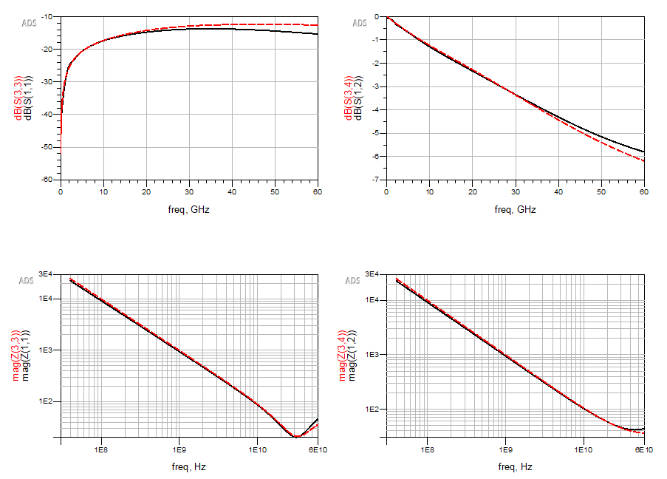
3 Cavities – Via Model
HFSS
Calculation
12mil + 12mil + 12mil
12mil + 8mil + 12mil
S11
S12
S11
S12
Z11
Z12
Z11
Z12

Slide 6
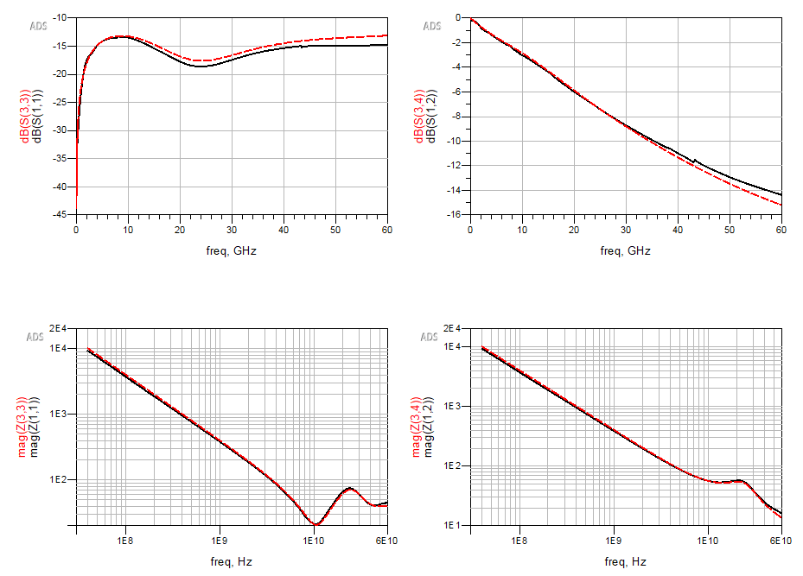
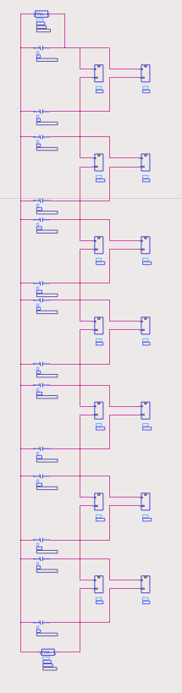
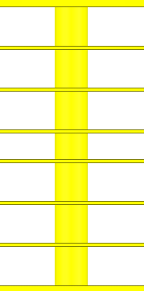
Full Stack – Via Model
HFSS
Calculation
P1
P1
A
A
12 mil
B
B
12 mil
S11
S12
C
12 mil
C
D
8 mil
D
E
12 mil
E
F
12 mil
G
12 mil
F
Z11
Z12
P2
G
P2

Slide 7
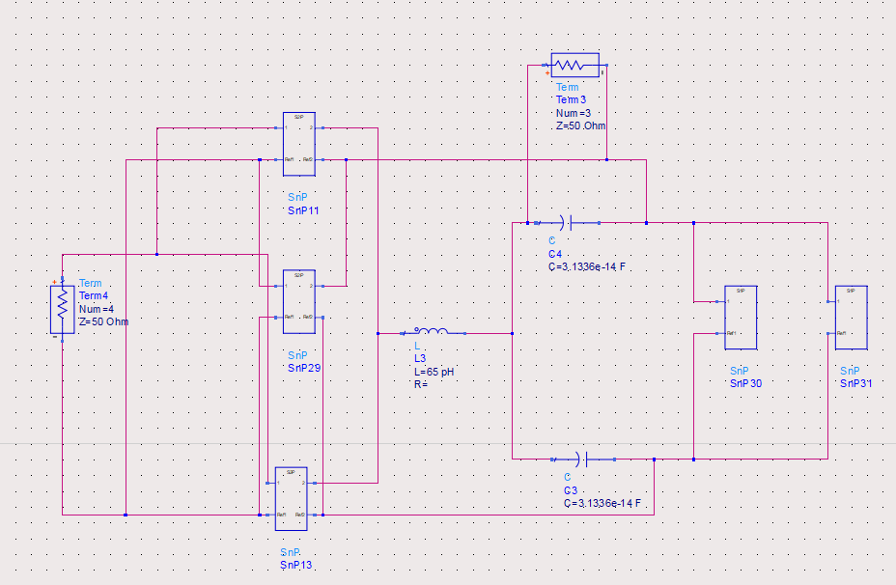
New Equivalent CKT Model for Via-Stripline
Port 1
Stripline Model
Stripline
(200mil)
Port 2
Via Model
200mil
Stripline in antipad region
Stripline in antipad region

Slide 8
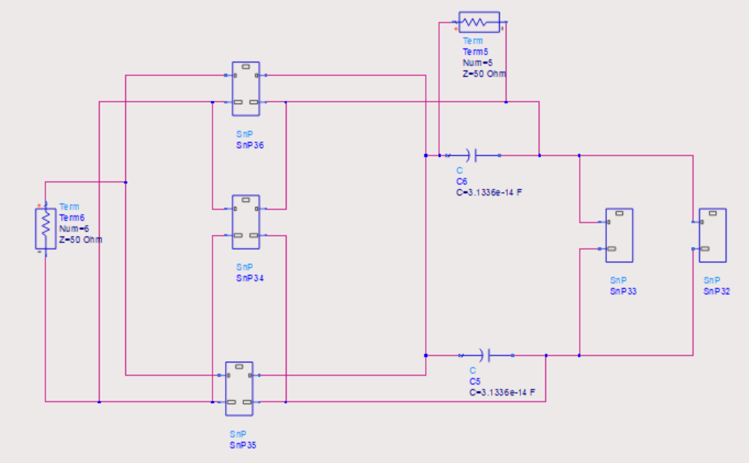
Previous Via-Stripline Model
Power
Power
Ground
Ground
In one cavity
Parallel-plate mode
Stripline mode
P1
P2
Stripline Model
Stripline
(220mil)
200mil
Via Model

Slide 9
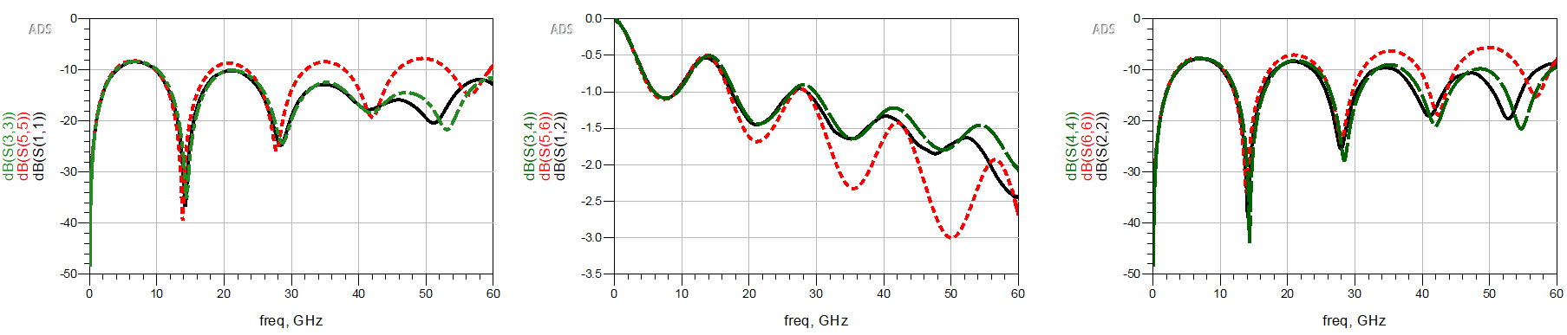
Results Comparison
HFSS
Previous Model: via model + stripline model
New Model: via model + tx-line in antipad region + stripline model
S11
S12
S22

Slide 10
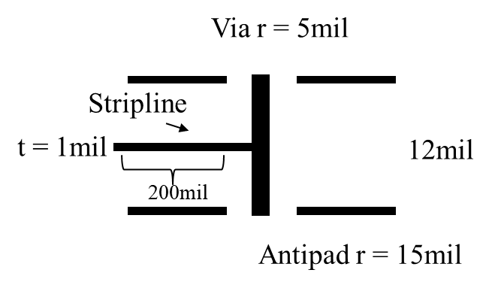
Via-Stripline Model – Single-ended Validation Cases – One side
Case | Via r [mil] | Antipad r [mil] | Cavity height [mil] | Stripline length [mil]
1 (reference) | 5 | 15 | 12 | 200
2 | 5 | 15 | 12 | 100
3 | 5 | 15 | 12 | 500
4 | 5 | 15 | 12 | 10
5 | 5 | 15 | 12 | 1
6 | 5 | 15 | 8 | 200
7 | 5 | 15 | 20 | 200
8 | 5 | 10 | 12 | 200
9 | 5 | 20 | 12 | 200
10 | 2 | 15 | 12 | 200
11 | 10 | 15 | 12 | 200
12 (from Natalia)

Slide 11
Stripline Length
Via r = 5mil
Case | Via r [mil] | Antipad r [mil] | Cavity height [mil] | Stripline length [mil]
1 (reference) | 5 | 15 | 12 | 200
2 | 5 | 15 | 12 | 100
3 | 5 | 15 | 12 | 500
4 | 5 | 15 | 12 | 10
5 | 5 | 15 | 12 | 1
6 | 5 | 15 | 8 | 200
7 | 5 | 15 | 20 | 200
8 | 5 | 10 | 12 | 200
9 | 5 | 20 | 12 | 200
10 | 2 | 15 | 12 | 200
11 | 10 | 15 | 12 | 200
12 (from Natalia)
Stripline
t = 1mil
12mil
200mil
Antipad r = 15mil
Change stripline length

Slide 12
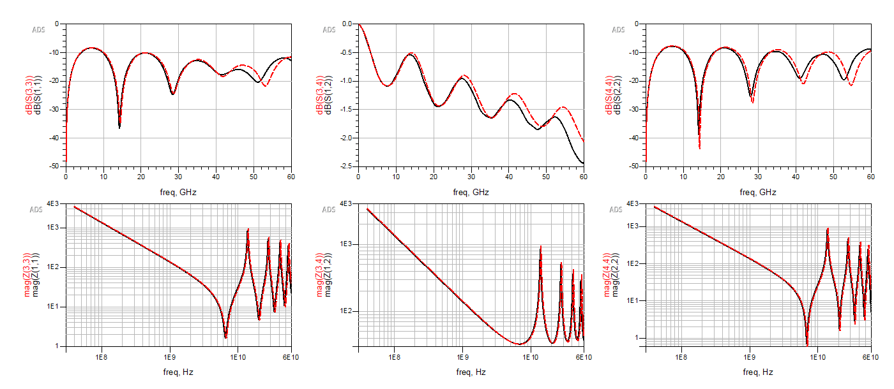
Stripline length = 200 mil
S11
S12
S22
Z11
Z12
Z22

Slide 13
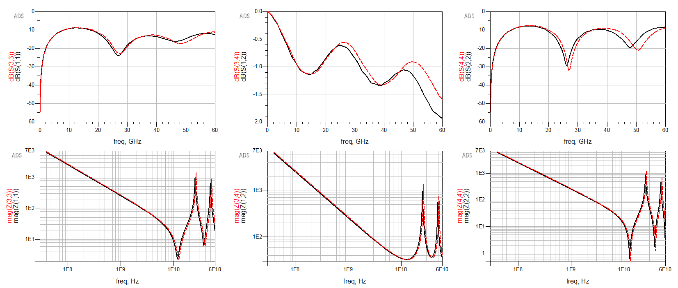
Stripline length = 100 mil
S11
S12
S22
Z11
Z12
Z22

Slide 14
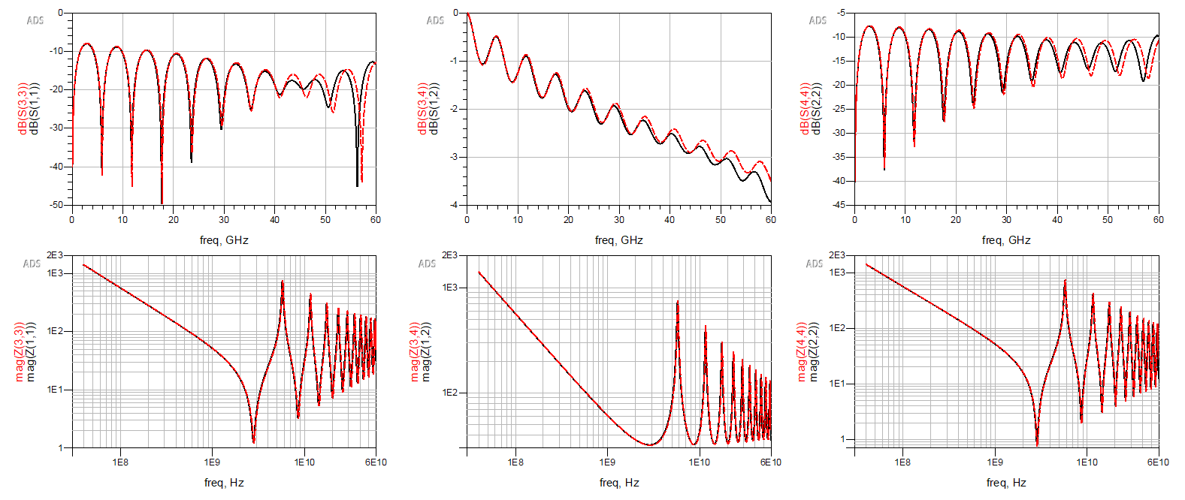
Stripline length = 500 mil
S11
S12
S22
Z11
Z12
Z22

Slide 15
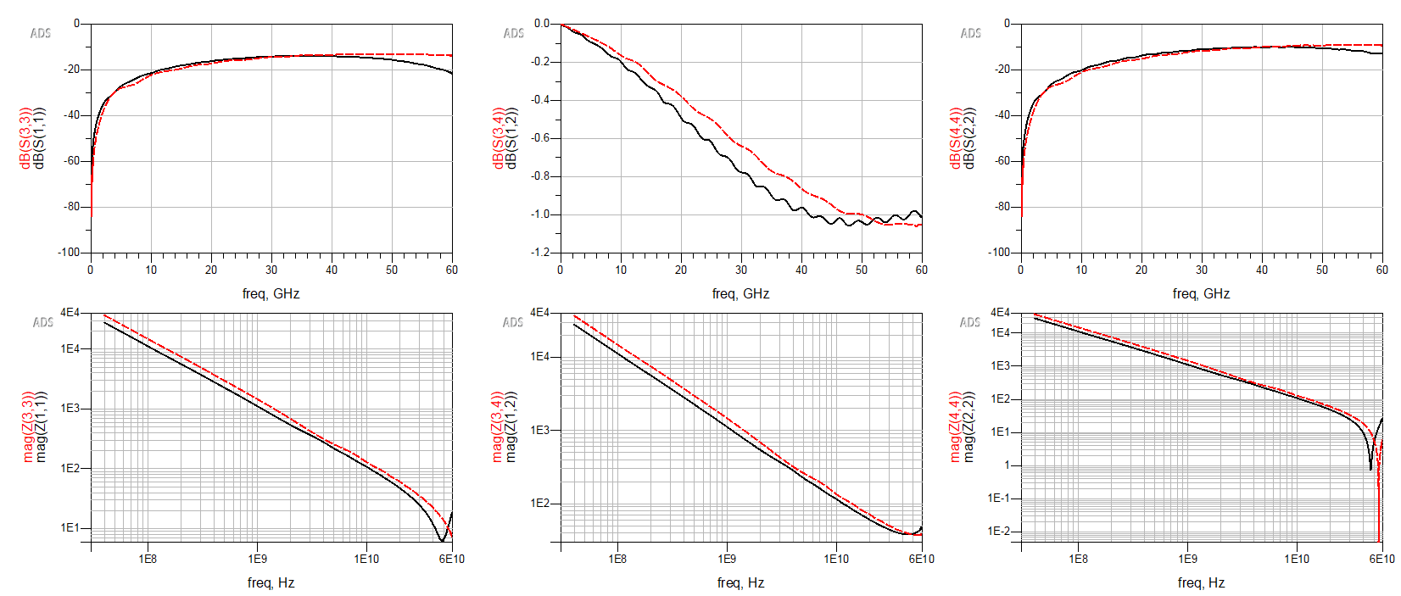
Stripline length = 10 mil
S11
S12
S22
Z11
Z12
Z22

Slide 16
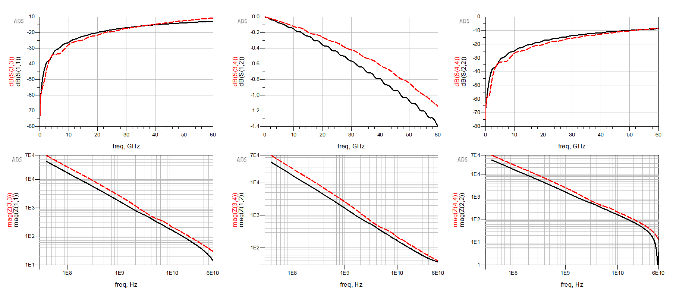
Stripline length = 1 mil
S11
S12
S22
Z11
Z12
Z22

Slide 17
Cavity Height
Via r = 5mil
Case | Via r [mil] | Antipad r [mil] | Cavity height [mil] | Stripline length [mil]
1 (reference) | 5 | 15 | 12 | 200
2 | 5 | 15 | 12 | 100
3 | 5 | 15 | 12 | 500
4 | 5 | 15 | 12 | 10
5 | 5 | 15 | 12 | 1
6 | 5 | 15 | 8 | 200
7 | 5 | 15 | 20 | 200
8 | 5 | 10 | 12 | 200
9 | 5 | 20 | 12 | 200
10 | 2 | 15 | 12 | 200
11 | 10 | 15 | 12 | 200
12 (from Natalia)
Stripline
t = 1mil
12mil
200mil
Antipad r = 15mil
Change cavity height

Slide 18
Cavity height = 12mil
S11
S12
S22
Z11
Z12
Z22

Slide 19
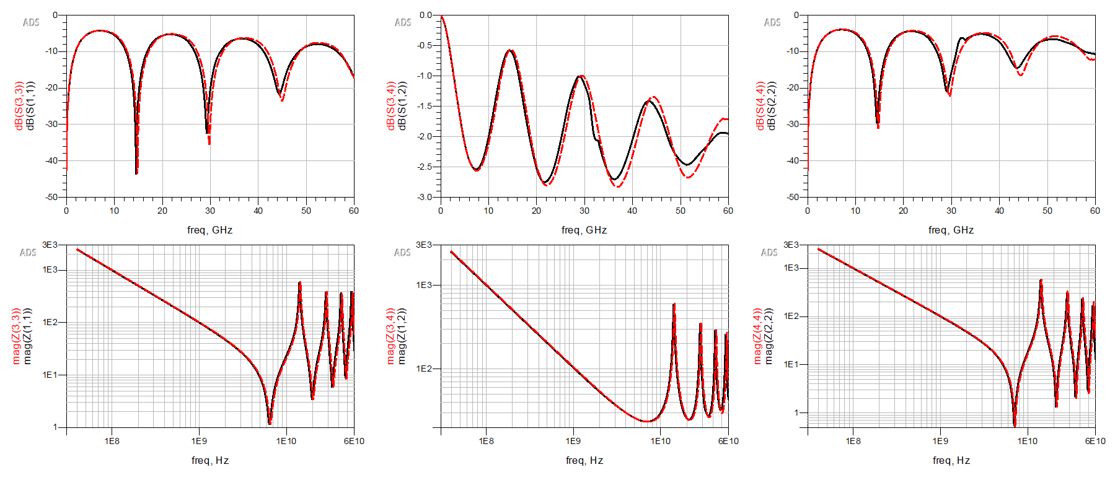
Cavity height = 8mil
S11
S12
S22
Z11
Z12
Z22

Slide 20
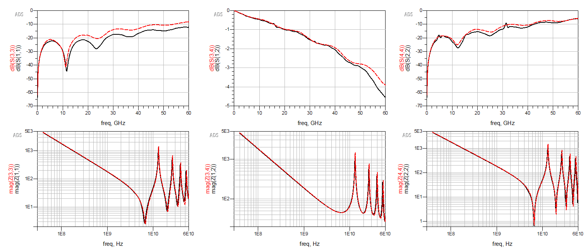
Cavity height = 20mil
S11
S12
S22
Z11
Z12
Z22

Slide 21
Antipad Radius
Via r = 5mil
Case | Via r [mil] | Antipad r [mil] | Cavity height [mil] | Stripline length [mil]
1 (reference) | 5 | 15 | 12 | 200
2 | 5 | 15 | 12 | 100
3 | 5 | 15 | 12 | 500
4 | 5 | 15 | 12 | 10
5 | 5 | 15 | 12 | 1
6 | 5 | 15 | 8 | 200
7 | 5 | 15 | 20 | 200
8 | 5 | 10 | 12 | 200
9 | 5 | 20 | 12 | 200
10 | 2 | 15 | 12 | 200
11 | 10 | 15 | 12 | 200
12 (from Natalia)
Stripline
t = 1mil
12mil
200mil
Antipad r = 15mil
Change antipad size

Slide 22
Antipad r = 15mil
S11
S12
S22
Z11
Z12
Z22

Slide 23
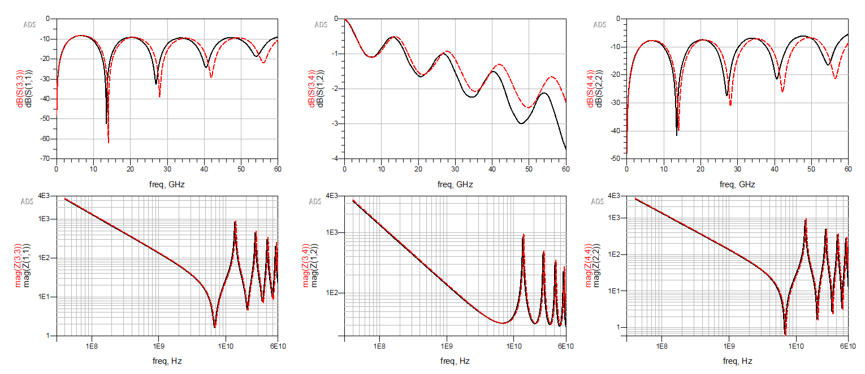
Antipad r = 10mil
S11
S12
S22
Z11
Z12
Z22

Slide 24
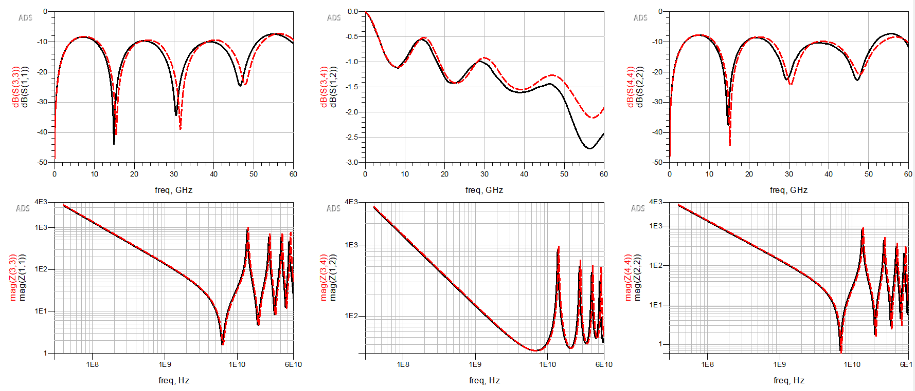
Antipad r = 20mil
S11
S12
S22
Z11
Z12
Z22

Slide 25
Via Radius
Via r = 5mil
Case | Via r [mil] | Antipad r [mil] | Cavity height [mil] | Stripline length [mil]
1 (reference) | 5 | 15 | 12 | 200
2 | 5 | 15 | 12 | 100
3 | 5 | 15 | 12 | 500
4 | 5 | 15 | 12 | 10
5 | 5 | 15 | 12 | 1
6 | 5 | 15 | 8 | 200
7 | 5 | 15 | 20 | 200
8 | 5 | 10 | 12 | 200
9 | 5 | 20 | 12 | 200
10 | 2 | 15 | 12 | 200
11 | 10 | 15 | 12 | 200
12 (from Natalia)
Stripline
t = 1mil
12mil
200mil
Antipad r = 15mil
Change via r size

Slide 26
r = 5mil
S11
S12
S22
Z11
Z12
Z22

Slide 27
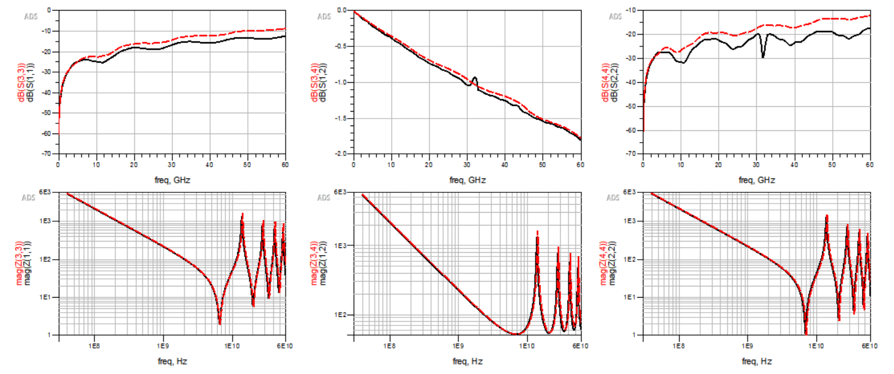
r = 2mil
S11
S12
S22
Z11
Z12
Z22

Slide 28
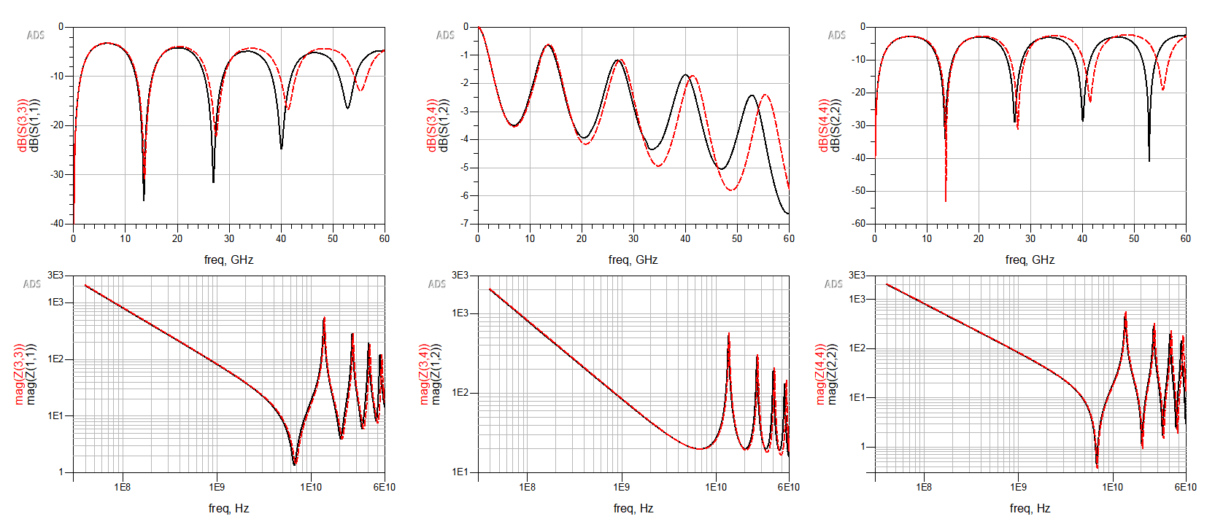
r = 10mil
S11
S12
S22
Z11
Z12
Z22

Slide 29
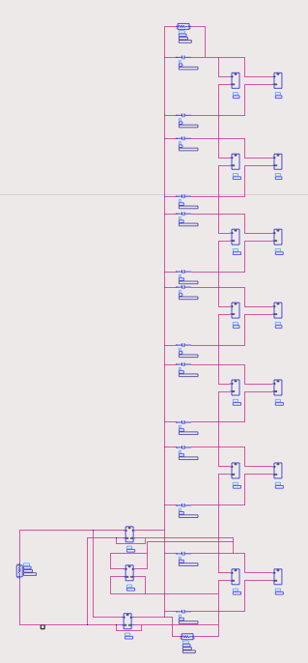
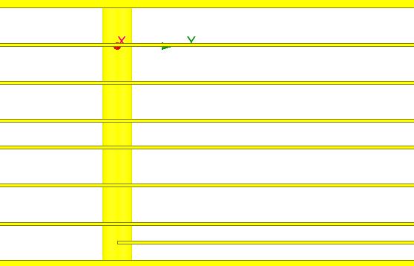
Multilayer Structure – Via + Stripline Model
P1
P1
A
A
12 mil
B
B
12 mil
C
12 mil
C
D
8 mil
D
E
12 mil
E
F
12 mil
G
12 mil
F
P2
200mil
P2
Str
G

Slide 30
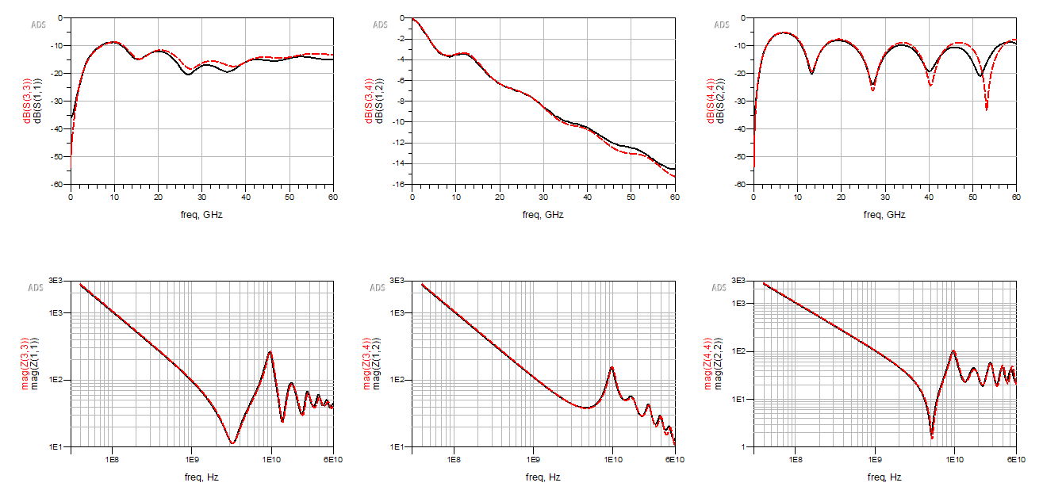
Multilayer Structure – Via + Stripline Model
HFSS
Equivalent ckt
S11
S12
S22
Z11
Z12
Z22

Slide 31
Single-ended – Complete Transition Model
Via r = 5mil
Stripline
t = 1mil
12mil
200mil
Antipad r = 15mil

Slide 32
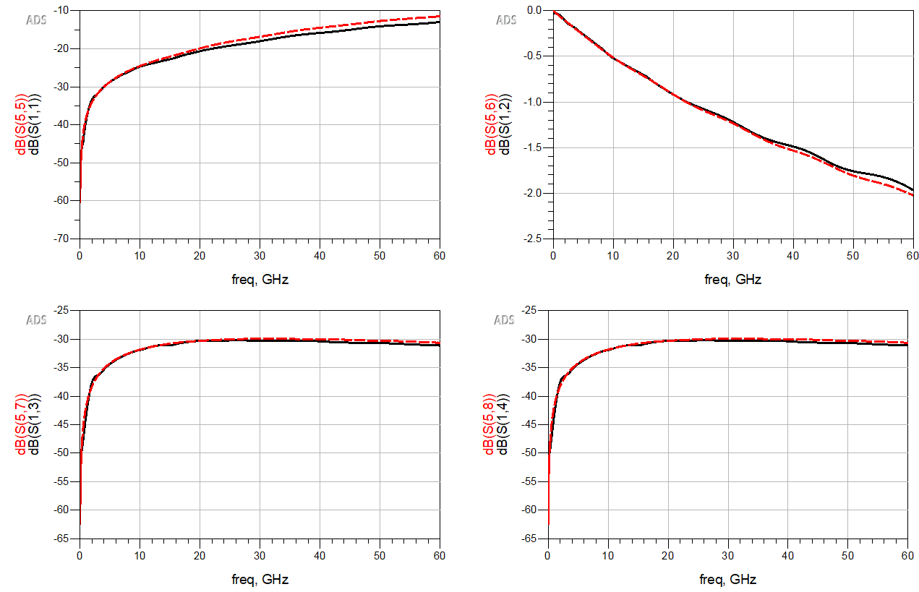
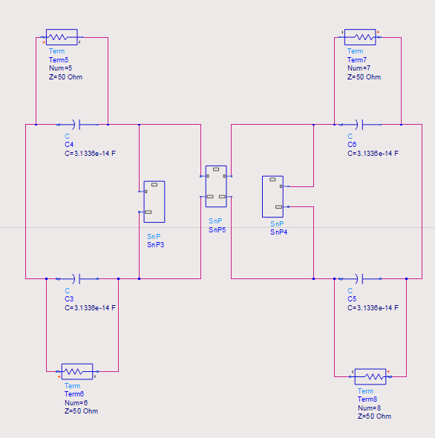
Two Vias
HFSS
Calculation
Port 1
Port 3
Via r = 5mil
12mil
200mil
Antipad r = 15mil
Port 2
Port 4
230mil

Slide 33
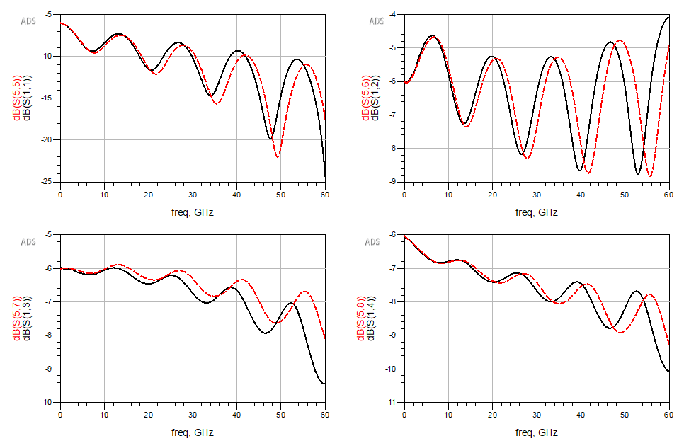
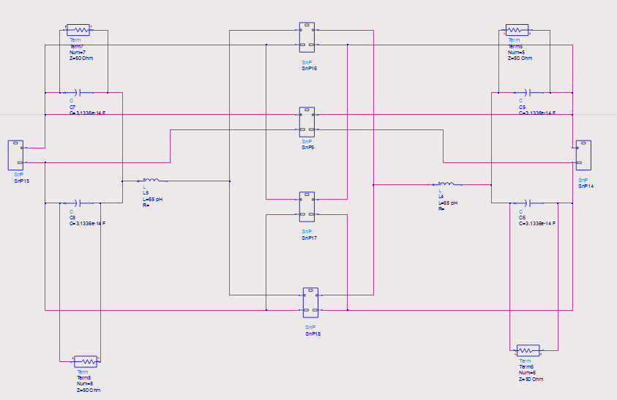
Two Vias + One Stripline – 4 ports
HFSS
Calculation
Port 1
Port 3
Stripline
Via r = 5mil
12mil
t = 1mil
200mil
Antipad r = 15mil
Port 2
Port 4
230mil

Slide 34
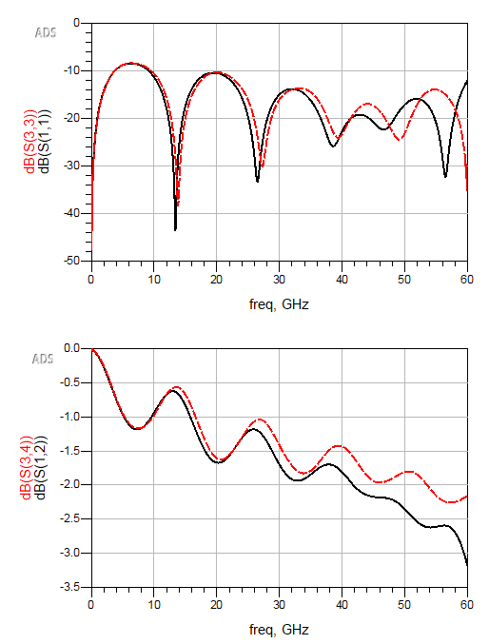
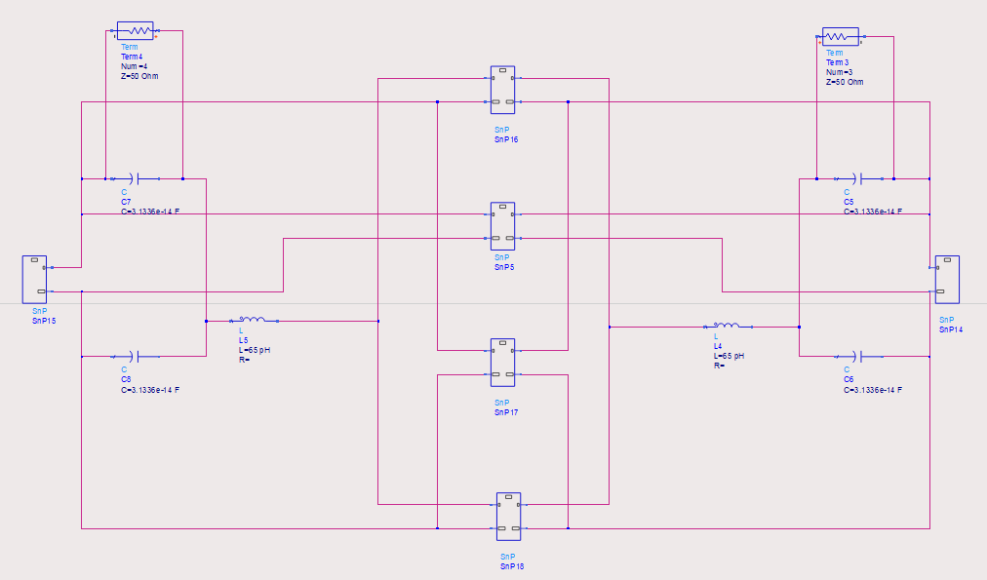
Two Vias + One Stripline – 2 ports
HFSS
Calculation
Port 1
Port 2
Stripline
Via r = 5mil
12mil
t = 1mil
200mil
Antipad r = 15mil
230mil

Slide 35
1 Differential Pair – One Side – Separated Antipad
Antipad r = 15mil
40mil
Stripline
t = 1mil
200mil
12mil
Via r = 5mil

Slide 36
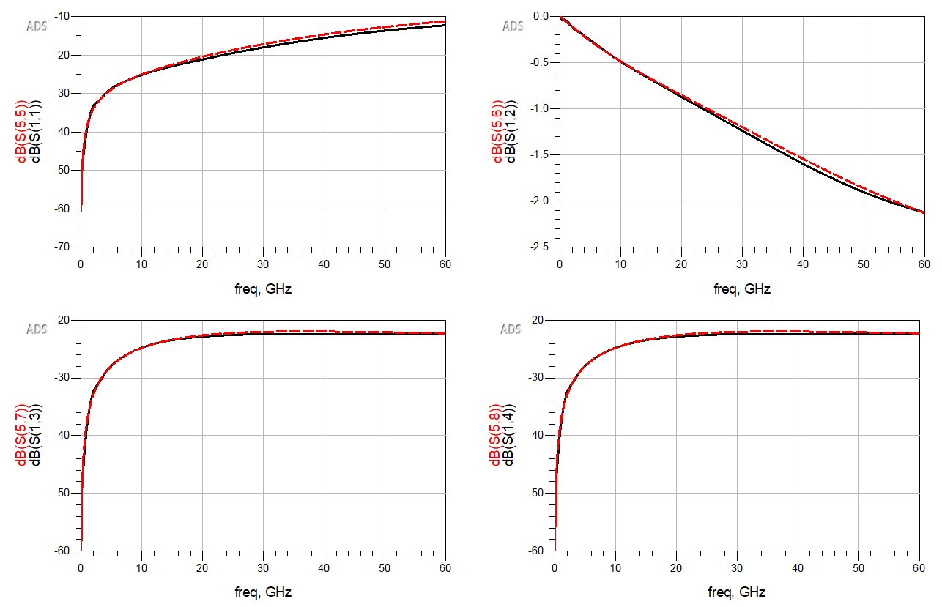
Differential Vias
HFSS
Calculation
Port 1
Port 3
Via r = 5mil
12mil
Antipad r = 15mil
Port 2
Port 4
40mil

Slide 37
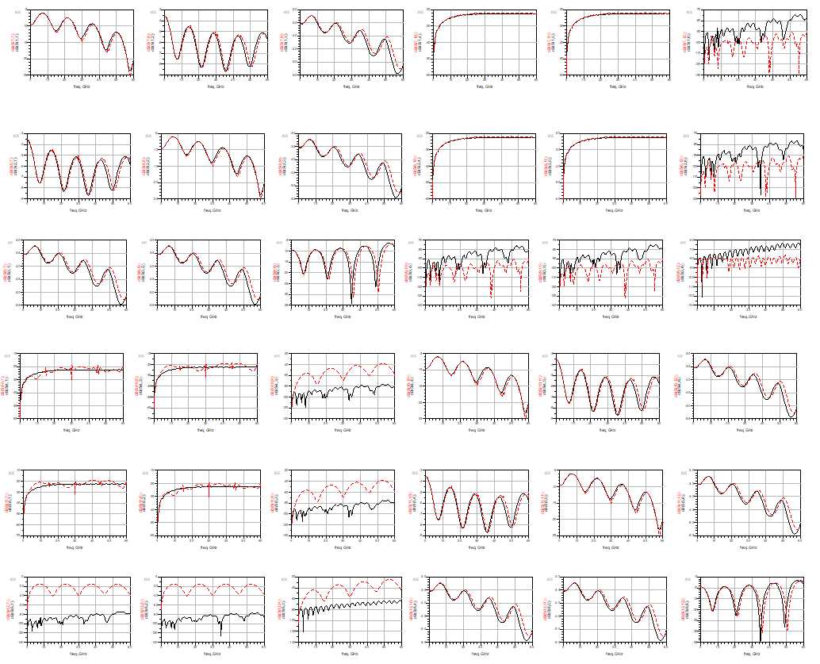
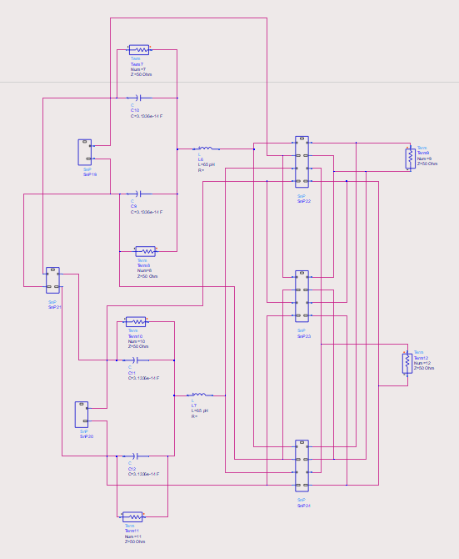
Differential Vias + 2 striplines 6 ports
HFSS
Calculation
Port 1
Port 4
Port 3
Port 2
Port 6
Port 5

Slide 38
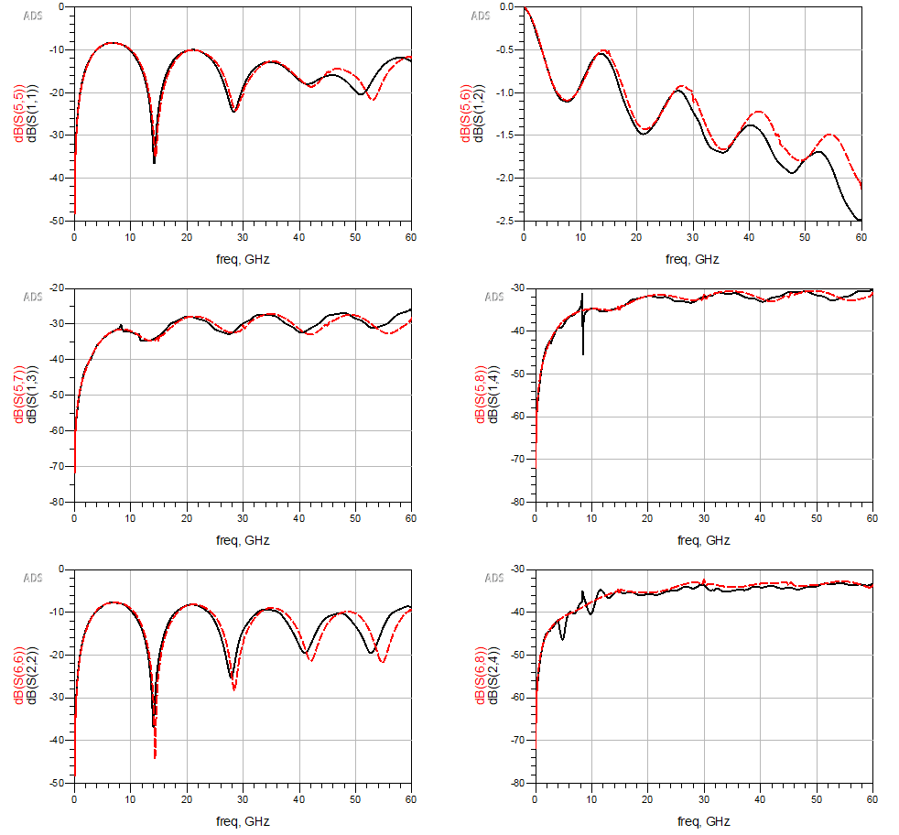
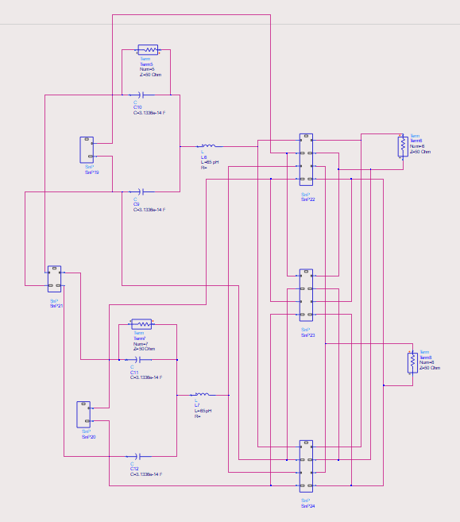
Differential Vias + 2 striplines – 4 ports
HFSS
Calculation
Port 1
Port 3
Port 2
Port 4

Slide 39
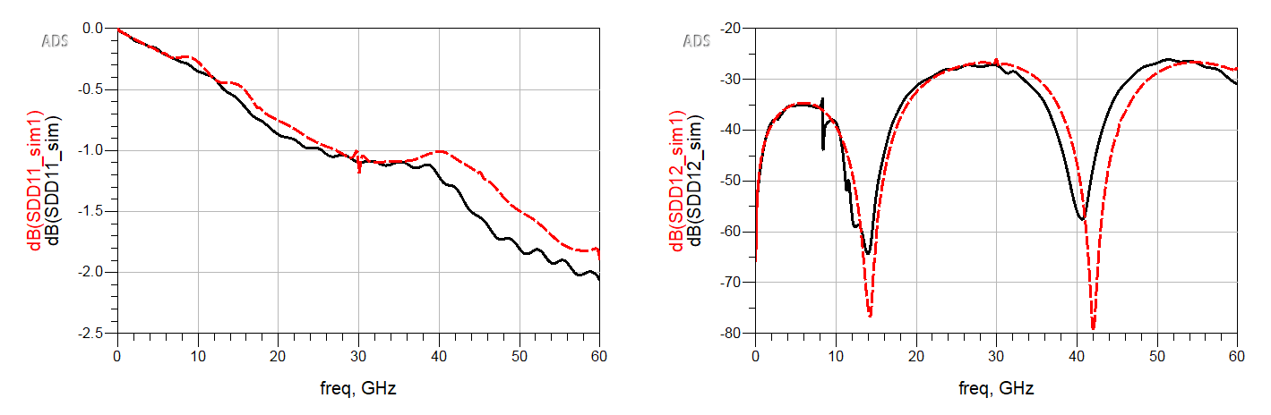
Differential Vias + 2 striplines – Mixed Mode
HFSS
Calculation
Differential Port 1
Differential Port 2

Slide 40
1 Differential Pair – Double Sides – Separated Antipad
Antipad r = 15mil
40mil
Stripline
t = 1mil
200mil
12mil
Via r = 5mil
230mil

Slide 41
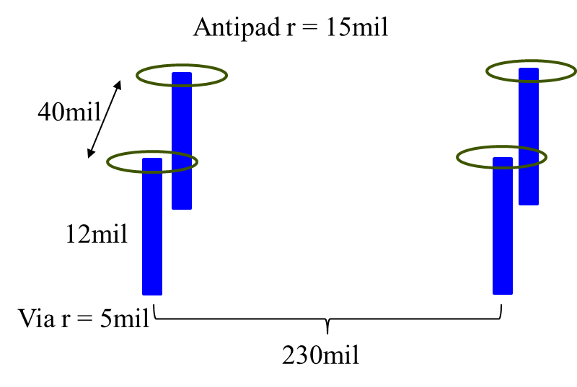
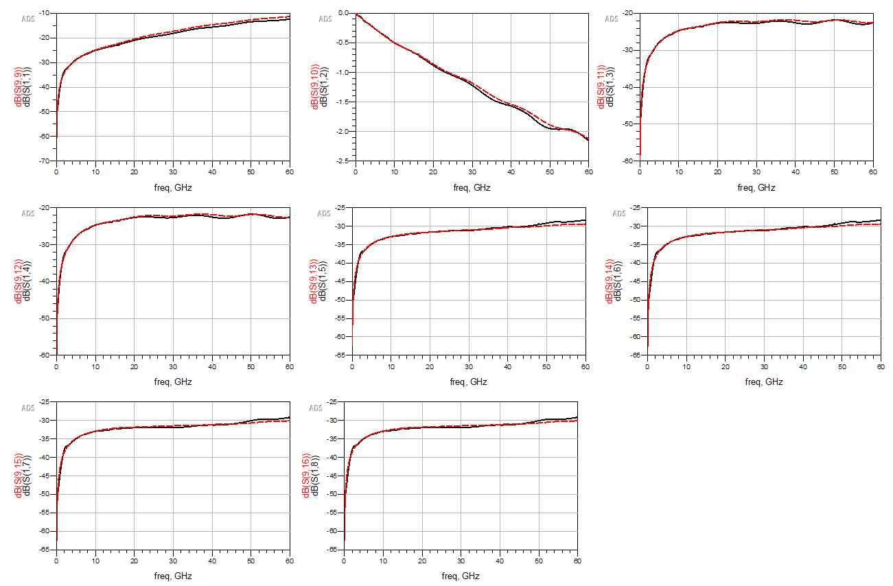
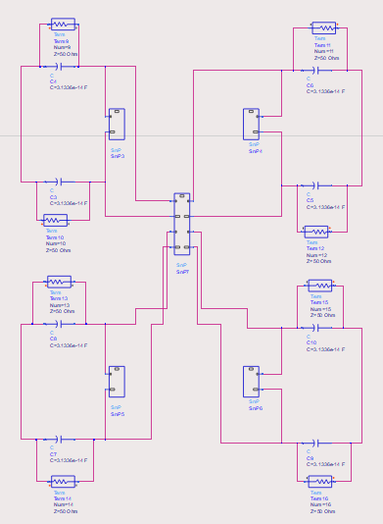
1 Pair of Differential Vias
HFSS
Calculation
Port 1
Port 5
Port 3
Port 7
Port 2
Port 6
Port 4
Port 8

Slide 42
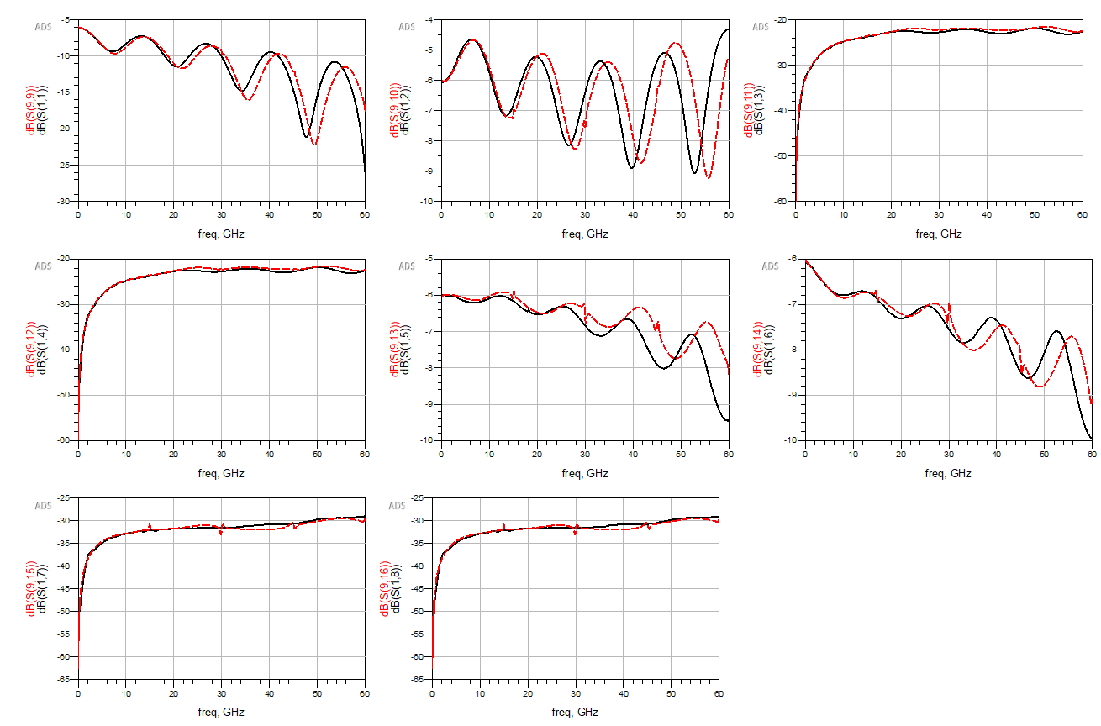
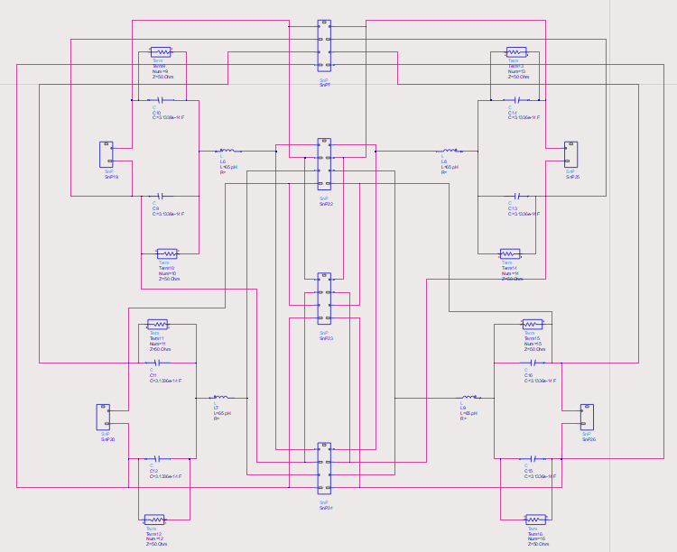
1 Pair of Differential Vias + 2 striplines – 8 ports
HFSS
Calculation
Port 1
Port 5
Port 3
Port 7
Port 2
Port 6
Port 4
Port 8

Slide 43
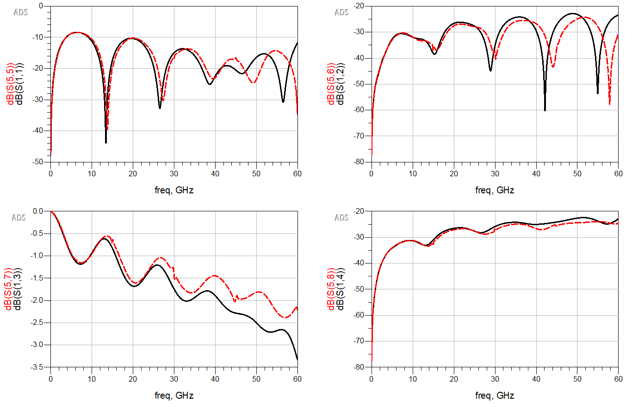
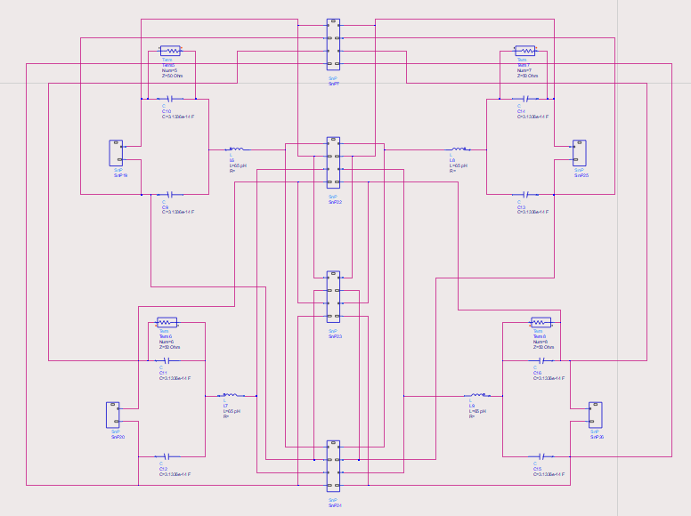
1 Pair of Differential Vias + 2 striplines – 4 ports
HFSS
Calculation
Port 1
Port 3
Port 2
Port 4

Slide 44
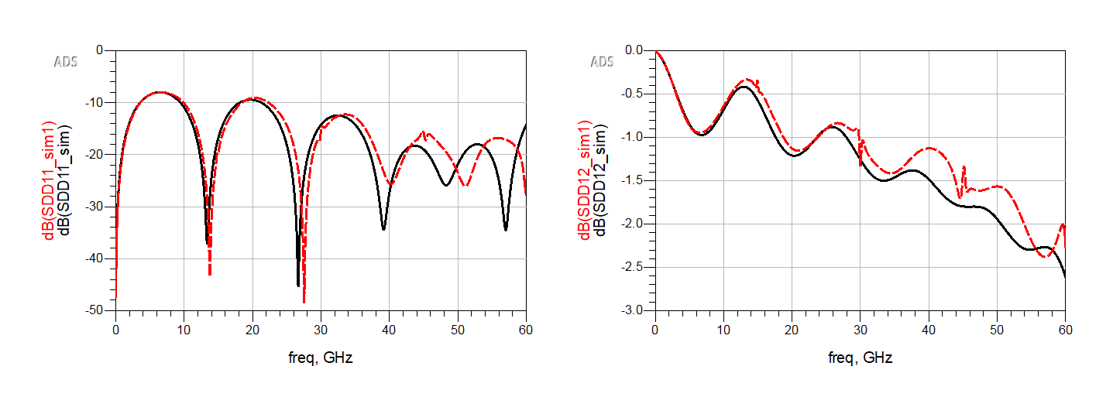
1 Pair of Differential Vias + 2 striplines –Mixed Mode
HFSS
Calculation
Differential Port 1
Differential Port 2

Slide 45
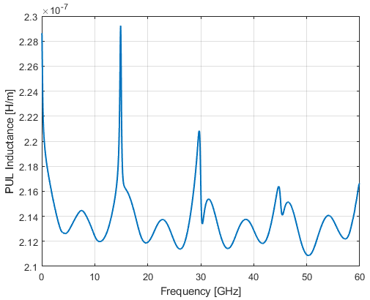
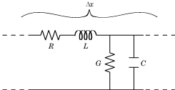
Obtain L from Stripline RLGC
Partial inductance used in the current model = 65 pH
@ 60GHz
R_pul = 1.6187e+03 Ω/m
L_pul = 2.1665e-07 H/m
G_pul = 2.1665e-07 S/m
C_pul = 2.1665e-07 F/m
@ 60GHz * 10mil
L = 2.1665e-07 H/m *10 mil
= 55.028 pH
*From the MATLAB s2rlgc conversion function

Slide 46
Inductance Comparison
Case | Via r [mil] | Antipad r [mil] | Cavity height [mil] | Stripline length [mil] | Partial L [pH] | Tx-line L [pH]
1 | 5 | 15 | 12 | 200 | 64.91 | 55.03
6 | 5 | 15 | 8 | 200 | 64.91 | 48.83
7 | 5 | 15 | 20 | 200 | 64.91 | 96.46
8 | 5 | 10 | 12 | 200 | 21.56 | 27.51
9 | 5 | 20 | 12 | 200 | 120.12 | 82.54
10 | 2 | 15 | 12 | 200 | 144.65 | 114.04
11 | 10 | 15 | 12 | 200 | 15.34 | 17.26

Slide 47
Next Steps
Try with the tx-line L.
Validate two differential pairs (4 traces) with separate antipad.
Validate the cases with shared antipad.

